Slide 1
ECE-260
Tutorial 01

Slide 2
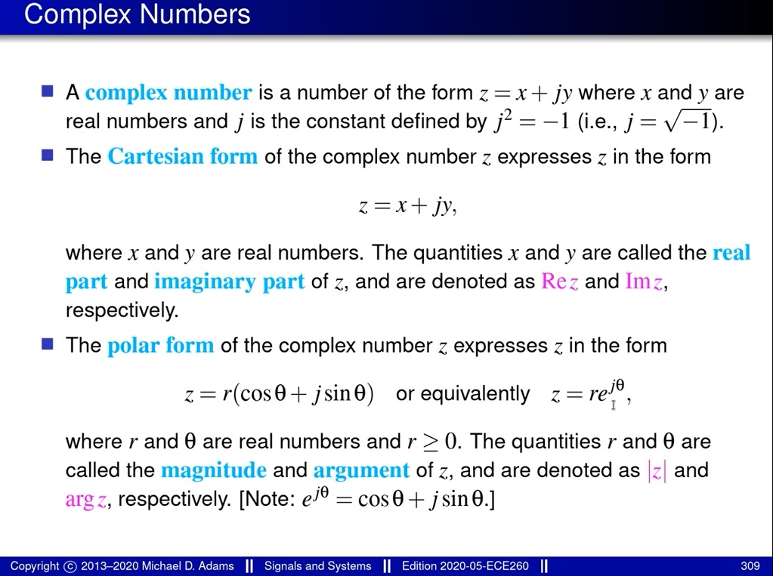
Review of Complex Numbers

Slide 3
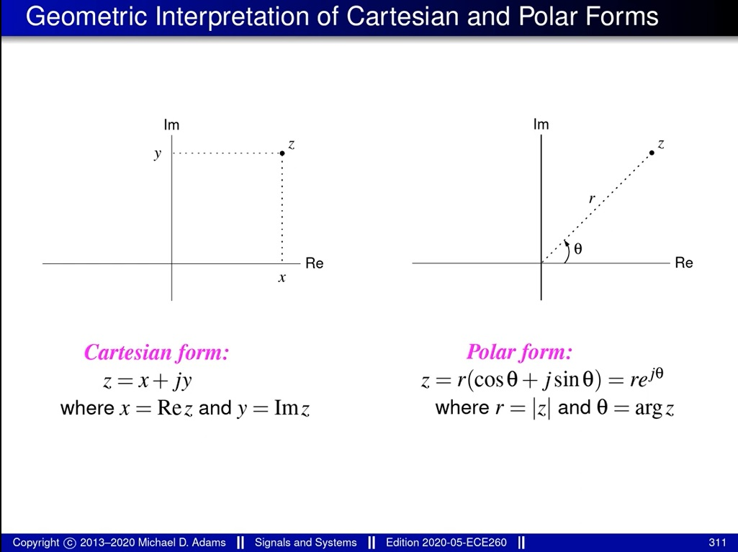
Review of Complex Numbers

Slide 4
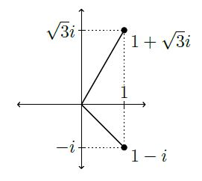


Question 01
$$z={\left(\frac{1−i}{1+\sqrt{3}i}\right)}^{24}$$
Find the real and imaginary parts of z.

Slide 5


Question 01
$$z={\left(\frac{1−i}{1+\sqrt{3}i}\right)}^{24}$$
Find the real and imaginary parts of z.
By De Moivre’s Theorem,
For all real ϴ and all integer n,

Slide 6
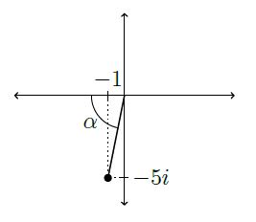

Question 02
Find Arg z and arg z for

Slide 7


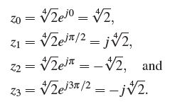

Question 03
Find the fourth roots of 2.
Sol.
Every complex number z has n distinct nth roots in the complex plane.

Slide 8

Question 04
Find the (finite) poles and zeros of the function

Slide 9
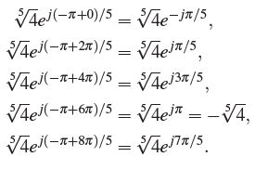
Question 04
Find the (finite) poles and zeros of the function

Slide 10
End of Tutorial 01

